Slide 1
BTC1877H
TEAM PROJECT
Exploring Blood Transfusions and Outcomes of Lung Transplant Patient
Presented By Group I
Agata Wolochacz, Avery Fitzpatrick, Aya Finkelstein, Nina He and Owais Amir

Slide 2

LUNG
TRANSPLANTS
ICU length of stay
End-Stage Lung Disease
Lung Transplant
Perioperative
bleeding
Blood Transfusions
Overall mortality
Risk of primary graft dysfunction (PGD)
Regular
Transfusions
Massive
Transfusions
< 10 units of RBC within 24 hours
> 10 units of RBC within 24 hours
  Oechslin P, Zalunardo MP, Inci I, et al. Established and potential predictors of blood loss during lung transplant surgery. J Thorac Dis. 2018;10(6):3845-3848.
  Siddiqui AS, Shakil J. Impact of blood products transfusion on patients in the immediate post-lung transplant period: a cohort study. Ann Transplant. 2024;29:e943652.

Slide 3
MASSIVE
TRANSFUSIONS
5.9% vs 32.7%
20 days vs
40 days
7.3%
vs 22.2%
Rates of PGD
Median time in ICU
One-year mortality
8.7%
vs 62.6%
4.5% vs 26.9%
9.5% vs 30.4%
Need for reinterventions
Need for dialysis
Need for tracheostomies
Those with massive transfusions have significantly worse overall outcomes compared to regular transfusions
  Wu KA, Kim JK, Rosser MG, et al. The impact of bleeding on outcomes following lung transplantation: a retrospective analysis using the universal definition of perioperative bleeding. J Cardiothorac Surg. 2024;19(1):466.

Slide 4
RESEARCH
QUESTIONS
  What are the characteristics of patients that require transfusions and what are the factors influencing the need and amount of transfusions?
  What is the impact of transfusion on patient outcomes, including mortality?
i. Who needs ANY transfusion?
    Logistic Regression
i. Does receiving more blood worsen survival?
    Survival Analysis (KM + CoxPH)
ii. Who need MASSIVE transfusion?
    Logistic Regression
ii. What influences the length of stay in ICU?
    Linear Regression
iii. What influences the AMOUNT of transfusion?
    Linear Regression

Slide 5
SELECTED
PREDICTORS
Age
Type
Pre Hb
LAS
Standalone
Standalone
Standalone
Standalone
Controlling for any age-related effects
Lung transplant type: bilateral or single
Control for baseline anemia
Higher scores indicate greater disease severity
Risk
BMI
Bleeding
Transfusion
Compound
Compound
Compound
Binary
Captures high surgical complexity: redo transplant, ECLS use, CF, and PH
Calculated from height and weight data
Baseline coagulopathy: INR > 1.5 or platelets < 150 predisposed to hemorrhage
Patient received any blood product within 24 hours of operation

Slide 6
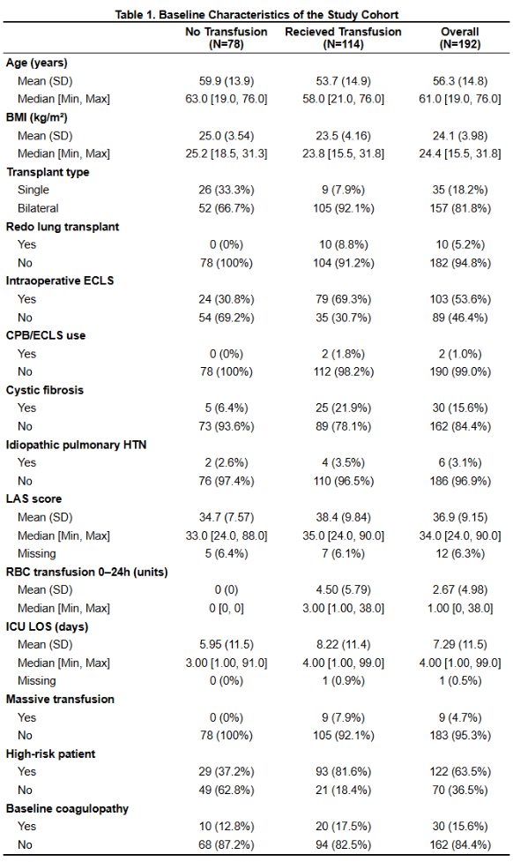
BASELINE
CHARACTERISTICS
Key characteristics to note:
  Repeat Lung Transplant
  Intraoperative ECLS
  Cystic Fibrosis
  ICU LOS

Slide 7
Question 1:
WHAT ARE THE CHARACTERISTICS OF PATIENTS THAT REQUIRE TRANSFUSIONS AND WHAT ARE THE FACTORS INFLUENCING THE NEED AND AMOUNT OF TRANSFUSIONS?

Slide 8
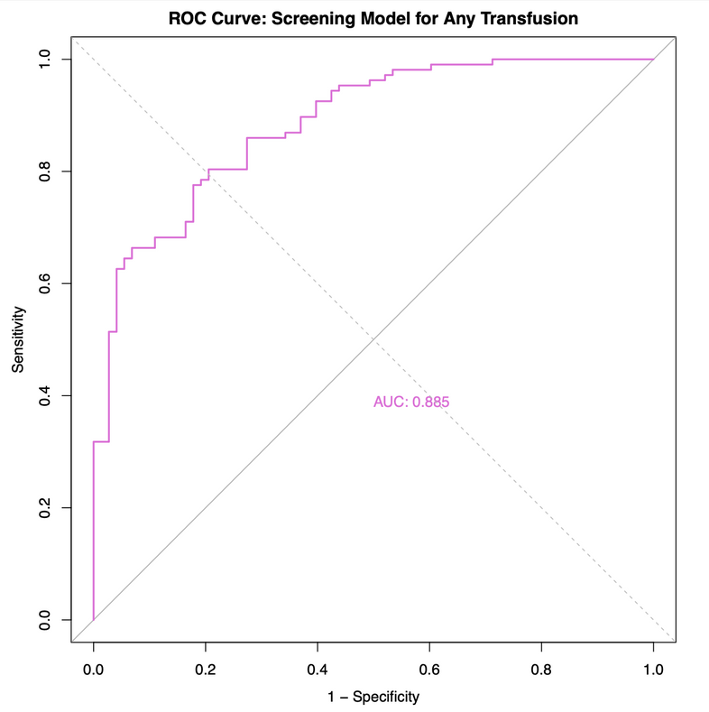
MODEL 1
MULTIVARIABLE LOGISTIC REGRESSION
THE SCREENING MODEL FOR WHO NEEDS TRANSFUSION
  Identified risk factors independently associated with any RBC transfusion within 24 hours
  8 predictor variables tested simultaneously
  Outcome: Any transfusion (≥1 unit RBC) vs. no transfusion
  n = 180 patients (107 events, EPV = 13.4)
  Assessed multicollinearity of predictors using VIF
    All VIF factors were under 2
  AUC = 0.885 shows the model discriminates well
    Measure of model fit not claim of furture predictive probability
Figure 1: Receiver Operating Characteristics (ROC) Curve for the Transfusion Screening Model

Slide 9
FINDINGS AND INTERPRETATION
The three strongest predictors are bilateral transplant, high-risk patient status, and preoperative hemoglobin
Variable | Coefficient | Odds Ratio | CI lower | CI upper | P value
Age | 0.041 | 1.042 | 1.006 | 1.082 | 0.027
Gender* | -0.224 | 0.799 | 0.335 | 1.935 | 0.614
BMI | -0.109 | 0.896 | 0.801 | 0.997 | 0.049
High Risk Patient | 2.164 | 8.705 | 3.56 | 23.275 | <0.001
Preop Hb | -0.08 | 0.924 | 0.891 | 0.952 | <0.001
Baseline Coagulopathy | -0.543 | 0.581 | 0.178 | 1.897 | 0.363
Bilateral Type | 2.323 | 10.206 | 3.122 | 38.998 | <0.001
LAS score | 0.039 | 1.04 | 0.986 | 1.111 | 0.173
Table 1: Multivariable Logistic Regression analysis for Any RBC Transfusion within 24 Hours Post-Transplant

Slide 10
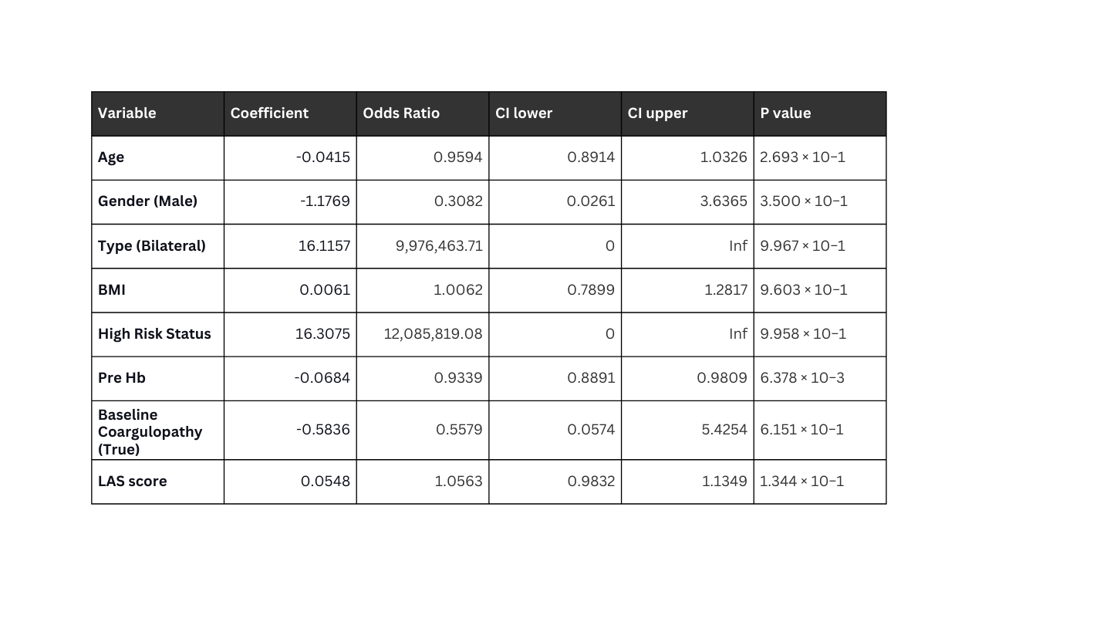
MODEL 2
MULTIPLE LOGISTIC REGRESSION
PREDICTORS INFLUENCING MASSIVE TRANSFUSION
  Identified risk factors independently associated with needing a massive transfusion (> 10 RBC units)
  8 predictor variables tested: age, gender, BMI, transplant type, high-risk patient indicator, pre-operative hemoglobin, baseline coagulopathy, LAS
  Outcome: Massive transfusion vs. no massive transfusion
  Assessed multicollinearity of predictors using VIF
    All VIF factors were under 1.8
  Estimated intercept: β​=−27.2174 with a p-value of 0.9957.
Table 2: Multivariable Logistic Regression For Any RBC Transfusion Within 24 Hours Post-Transplant

Slide 11
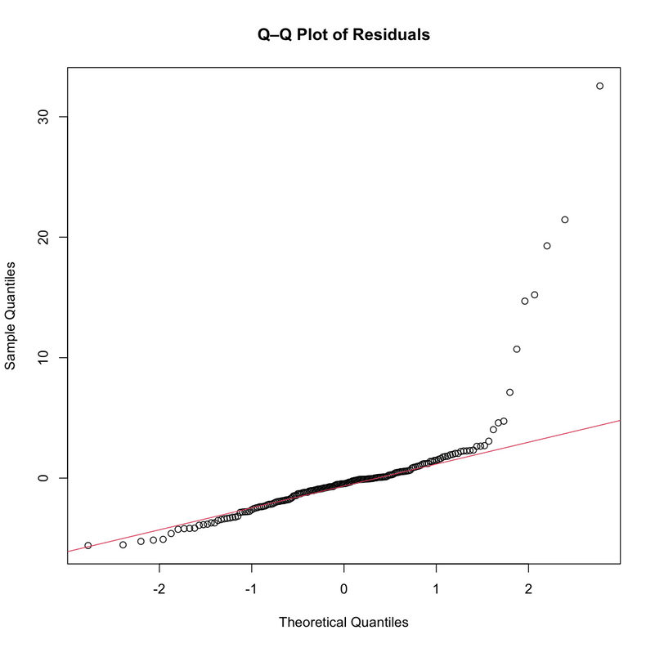
MODEL 3
MULTIPLE LINEAR REGRESSION
PREDICTORS INFLUENCING RBC TRANSFUSION VOLUME
  Identified risk factors independently associated with the volume of blood transfusion needed
  8 predictor variables tested (same as model 2)
  Outcome: Amount of transfusion volume (total_24hr_RBC)
  Assessed multicollinearity of predictors using VIF
    All VIF factors were under 1.6
  Homoscedasticity, linearity and normality assessments
    Square root transformation applied based on skewed distribution
Figure 2. Q-Q Plot For Transfusion Volume Model (Non-transformed)

Slide 12
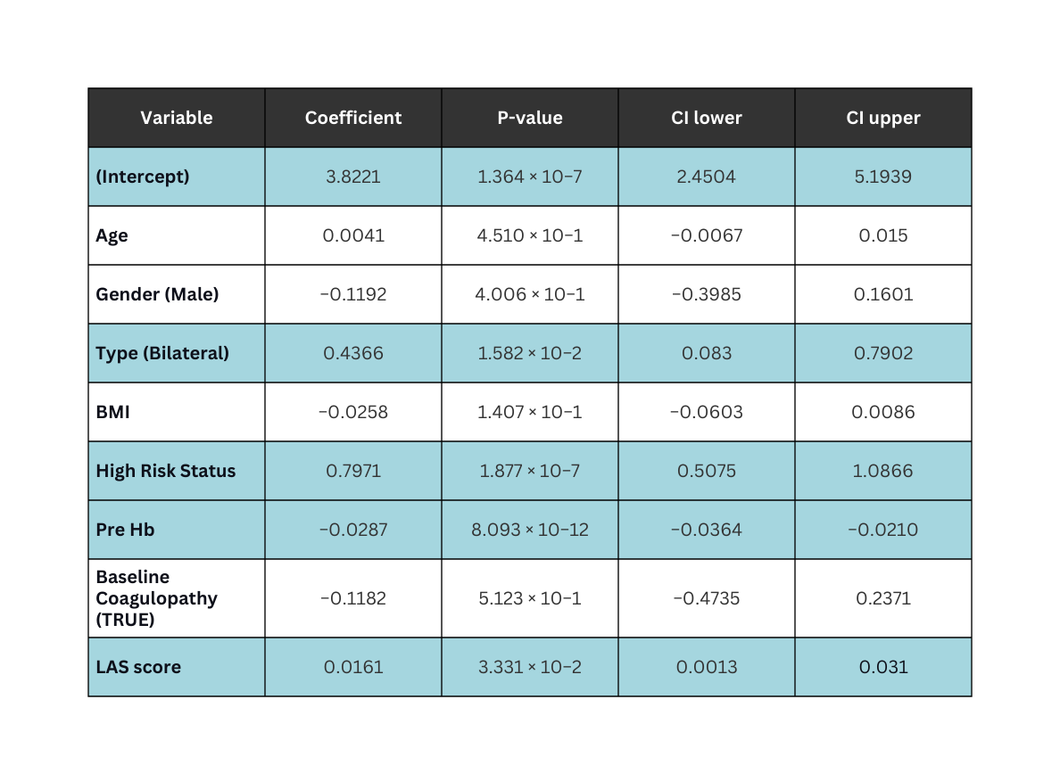
FINDINGS AND INTERPRETATION
Intercept, transplant type, high risk status, pre-operative Hb and LAS score were statistically significant in this model.
Table 3: Multiple Linear Regression for Transfusion Volume Model (sqrt-transformed)

Slide 13
Question 2:
WHAT IS THE IMPACT OF TRANSFUSION ON PATIENT OUTCOMES, INCLUDING MORTALITY?

Slide 14
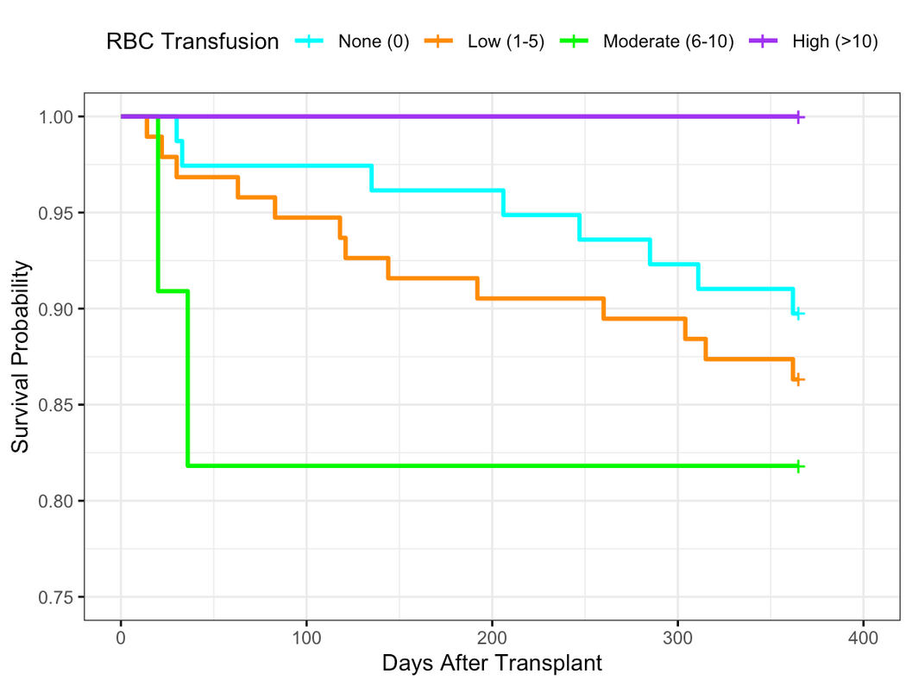
12-MONTH SURVIVAL BY RBC TRANSFUSION LEVEL
DOES TRANSFUSION VOLUME HARM THE PATIENT
Methods:
  Outcome: 12-month mortality
  Survival time: OR date → death (censor at 365 days)
  KM analysis: Transfusion groups
  Comparison: Log-rank test
Results:
  No significant survival difference (log-rank p = 0.6)
  High transfusion (>10 units): 0 deaths
  Visible differences likely due to small subgroup sizes
Figure 3: Kaplan-Meier curves stratified by RBC transfusion level
Notes:
We used Kaplan–Meier curves to visualize unadjusted 12-month survival across different transfusion levels. The KM method is appropriate here because patients die at different times, and many are censored at 12 months.
The log-rank p-value of 0.6 tells us there is no statistically significant difference in survival between groups.
That said, visually, a few trends are worth noting—even if they’re not significant.
The moderate transfusion group appears to have slightly lower early survival, while the no-transfusion group trends slightly higher. Interestingly, the high transfusion group had no deaths, though this group was very small (n=8), so we cannot overinterpret it.
These trends should be viewed as descriptive patterns rather than real associations, and they highlight areas where larger studies could explore whether certain transfusion ranges behave differently.
Overall, the KM curves suggest that transfusion volume does not meaningfully change 12-month survival in this cohort

Slide 15
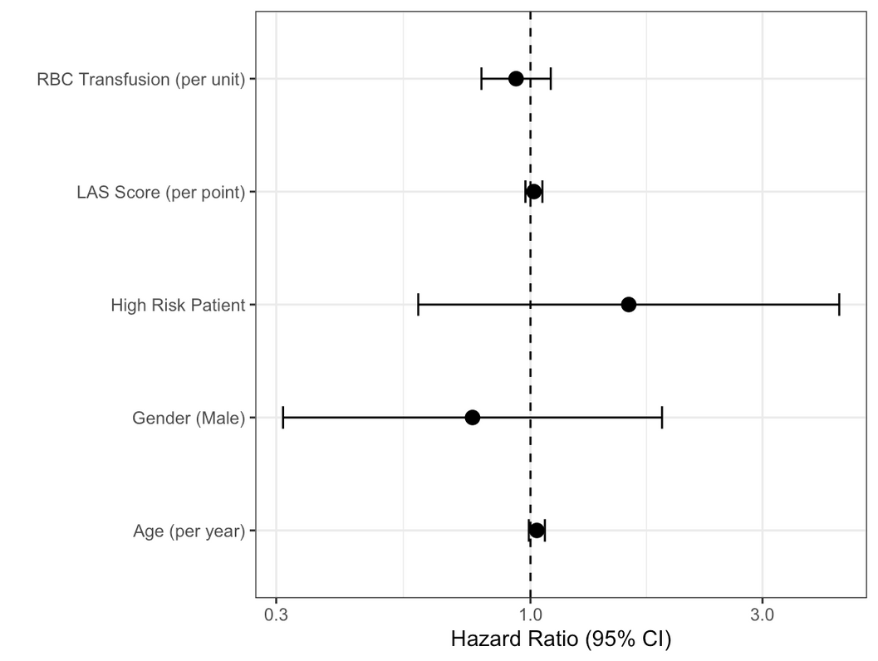
HAZARD RATIOS FOR 12-MONTH MORTALITY
DOES TRANSFUSION VOLUME HARM THE PATIENT
Methods:
  Exposure: RBC units (continuous)
  Covariates: Age, LAS score, high-risk status, gender
  Analysis: Complete case (missing LAS excluded)
  Diagnostics:
  PH assumption → met (global p = 0.93)
  Discrimination → C-index = 0.64
Results:
  RBC transfusion not associated with mortality
  HR = 0.93, p = 0.415
  No covariates were statistically significant
  Results likely limited by low event count (21 deaths)
Figure 4: Hazard Ratios for 12-Month Mortality
Notes:
To test whether transfusion independently affects mortality, we used a Cox proportional hazards model. Cox modeling is appropriate here because it estimates the relative risk of death over time while adjusting for confounders.
Our exposure was RBC transfusion volume, treated as a continuous variable so we could evaluate the effect of each additional unit. We adjusted for age, LAS score, high-risk status, and gender because these factors influence both transfusion decisions and mortality risk.
The hazard ratio for transfusion was 0.93, meaning each additional unit was associated with a 7% lower risk of death, though this was not statistically significant. None of the covariates reached significance, which likely reflects the low number of deaths—only 21 events in total.
Together, the adjusted model supports the same conclusion as the KM curves: transfusion volume does not appear to worsen 12-month survival.

Slide 16
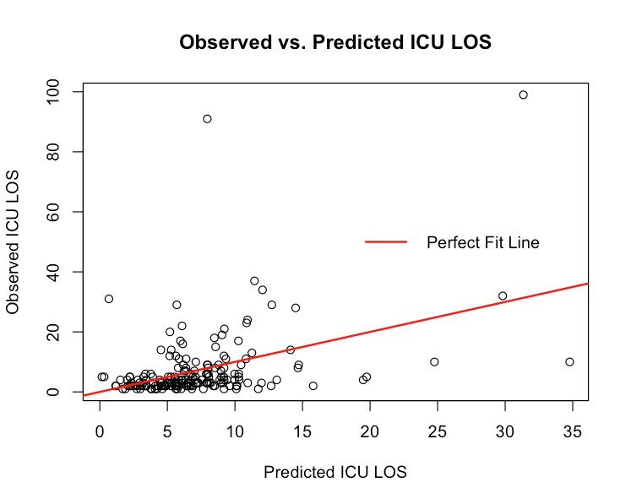
MODEL 2
MULTIPLE LINEAR REGRESSION
24HR RBC UNITS ON ICU LENGTH OF STAY
METHODS:
  Outcome: ICU Length of Stay in Days
  Variable of Interest: 24hr RBC Units
  Covariates:
    Age, Gender, BMI, High Risk, Baseline Anemia, Baseline Coagulopathy, Transplant Type,
RESULTS:
  SIGNIFICANT MODEL: F(9, 169) = 3.93, P <.001
  Adjusted R : 0.13
  Significant relationship:
    24hr RBC and ICU LOS
2
Figure 5: Observed vs. Predicted ICU LOS

Slide 17
MODEL 2: MULTIPLE LINEAR REGRESSION
FINDINGS AND INTERPRETATION
Variable | Coefficient | 95% CI | p-value
RBC Units Over 24hrs | 0.0806 | [0.429, 1.18] | 0.0000387
Age | -0.00168 | [-0.139, 0.136] | 0.981
Gender: Male | 0.376 | [-3.16, 3.92] | 0.834
BMI | 0.365 | [-0.0699, 0.800] | 0.0994
High Risk: True | 2.01 | [-1.74, 5.75] | 0.292
Baseline Anemia | -0.0196 | [-0.123, 0.0842] | 0.710
Baseline Coagulopathy: True | 2.90 | [-1.59, 7.39] | 0.204
Transplant Type: Bilateral | 1.66 | [-2.82, 6.13] | 0.466
LAS score | -0.137 | [-0.326, 0.0517] | 0.154

Slide 18
CONCLUSION
1
KEY PREDICTORS OF TRANSFUSION NEEDS WERE IDENTIFIED.
2
FINDINGS SUPPORT TARGETED PREOPERATIVE OPTIMIZATION
Bilateral Transplant
High-Risk Status
Low Pre-op Hb
Correct anemia
Plan for higher blood use in bilateral/high-risk cases
3
TRANSFUSION VOLUME WAS PREDICTED BY MORBIDITY
4
TRANSFUSION VOLUME AFFECTS HOSPITAL RESOURCES
Transplant Type
High Risk Status
Pre-operative Hb
LAS Score
Increased ICU Length of Stay

Slide 19
THANK YOU
ANY QUESTIONS?

